Slide 1
BOLO 4.0 Team Member(s): Alejandro Henao Edwin Alvarez Sosa Leonardo Martin Piero Messarina Product Owner(s): Samuel Ceballos Jason Cohen Instructor: Masoud Sadjadi School of Computing and Information Sciences Florida International University
Senior Project Final Presentation Spring 2016
May 5, 2016
Notes:
Greet your audience, thank them for attending your presentation, introduce yourself, introduce your project, introduce your team members, and quickly indicate what each of you did in a high-level manner, and put more emphasis on your part/contribution.

Slide 2
Problem definition
Whole Project: The BOLO (Be On the Look Out) web-application allows officers to quickly create BOLO's in real time using a mobile device or personal computer and simultaneously disseminating the information to a vast number of police officers with speed. The earlier version of the web-based BOLO application was moved from FIU servers to the IBM Bluemix Server; critical system functionality was lost in the process. Such functionality includes the ability to attach a PDF version of the issued BOLO within an e-mail alert. Bolo 4.0 will provide Bolo search & record management features, PDF generation feature of issued BOLO's, BOLO e-mail alerts to subscribed users, and agency/jurisdiction subscription management packaged in a user-friendly system.
Notes:
Introduce the problem that the whole project tackles and stay focused on the parts that you have been working. Indicate if there is an existing previous system, enumerate its problems/limitations, etc.

Slide 3
Problem Definition
My Part:
The previous iteration of the system does not offer PDF generation of issued BOLOs. This is an integral feature of the system since issued alerts must be generated server side.
PDF Generation
PDF Stylizing
PDF Rendering
Email Notification
Email Service Implementation
PDF Service Implementation

Slide 4
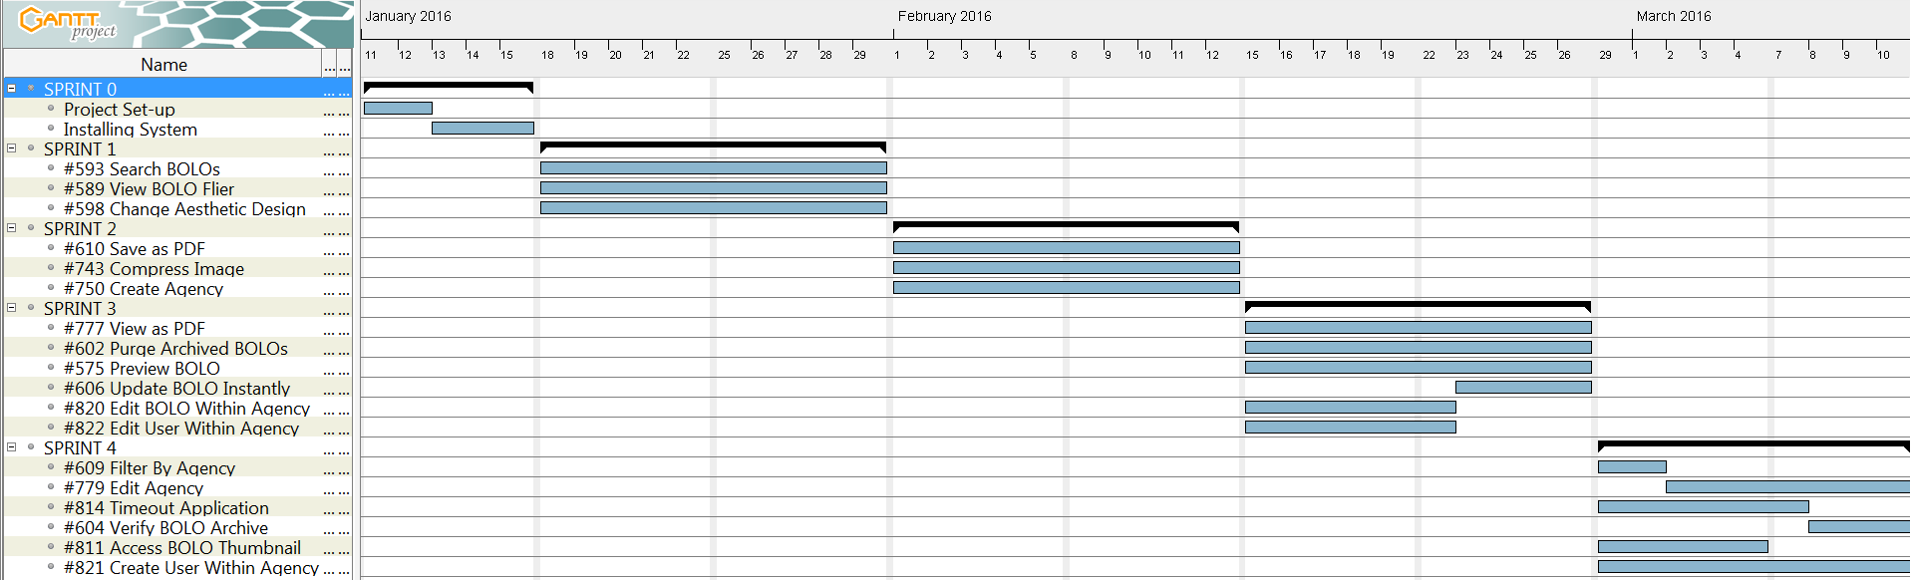
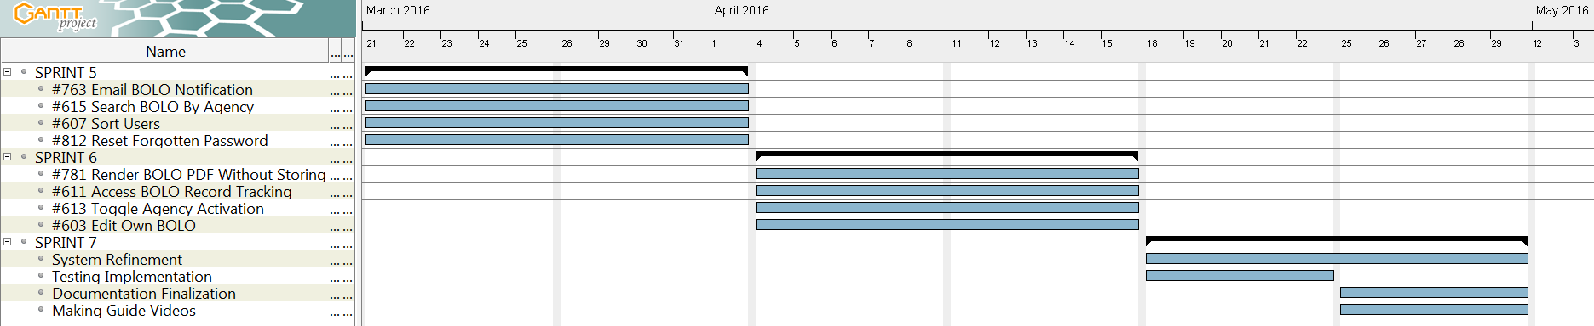
Project Management
Figure 1: Team Gantt chart
Notes:
Project Management (schedule for entire semester) (one slide; Gantt Chart).

Slide 5
Requirements: User Stories
#610 – Save as PDF
#777 – View as PDF
#763 – Email Bolo Notifications
#781 – Render BOLO PDF without storing
Notes:
4. Requirements:
4.1. User stories implemented (one or more slides).
4.2. UML use cases and the use case diagram for the implemented use cases (one or more slides).
4.3. UML sequence diagrams for the implemented use cases.

Slide 6
#763– Email New BOLO Notifications
Use case ID: Bolo-763
Preconditions:
The user must be logged in to the BOLO 4.0 system and be at the BOLO detail view
The user has successfully issued a BOLO to the persistent data source
Flow of events:
Use case begins when the user clicks submit to create a BOLO
The BOLO is created and stored
Use case ends when the notification email is sent to the received by the subscribers.
Constraints:
Usability: No previous training time
The process of returning the BOLO PDF should take less than 7 seconds
PDF file must not exceed 1MB

Slide 7
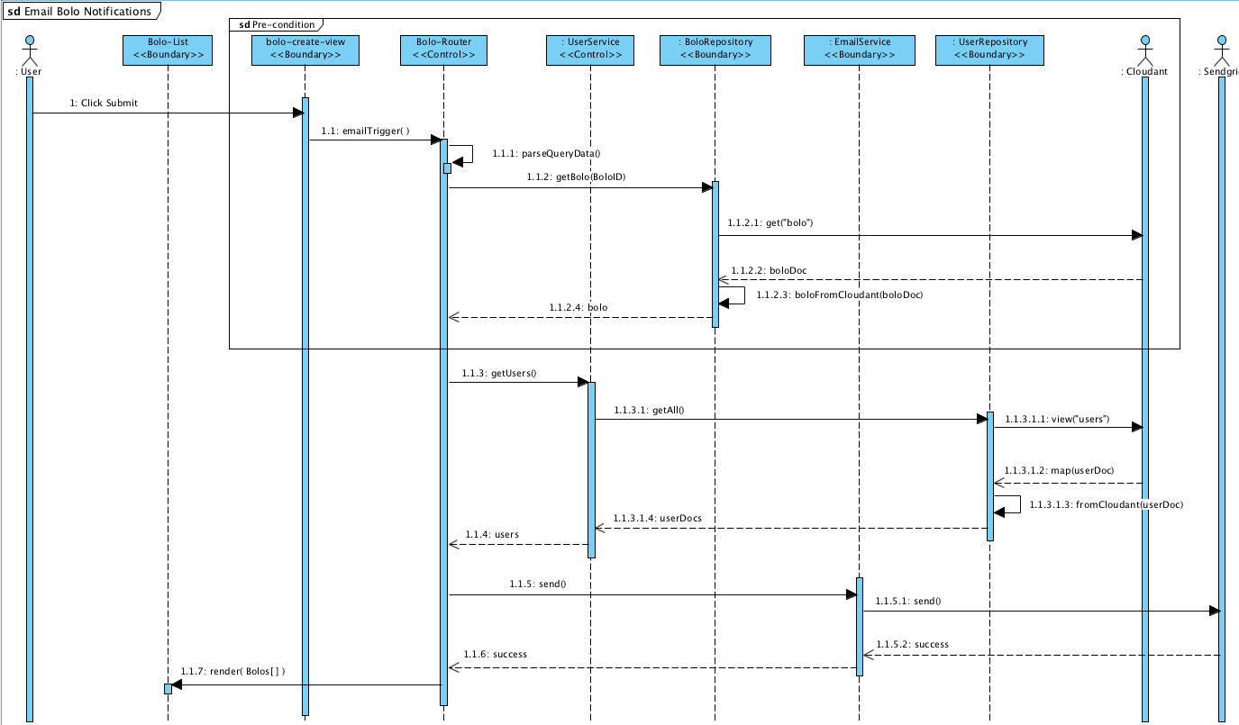
#763 – Email BOLO Notifications
Figure 2 – Email BOLO Notifications – Sequence Diagram

Slide 8
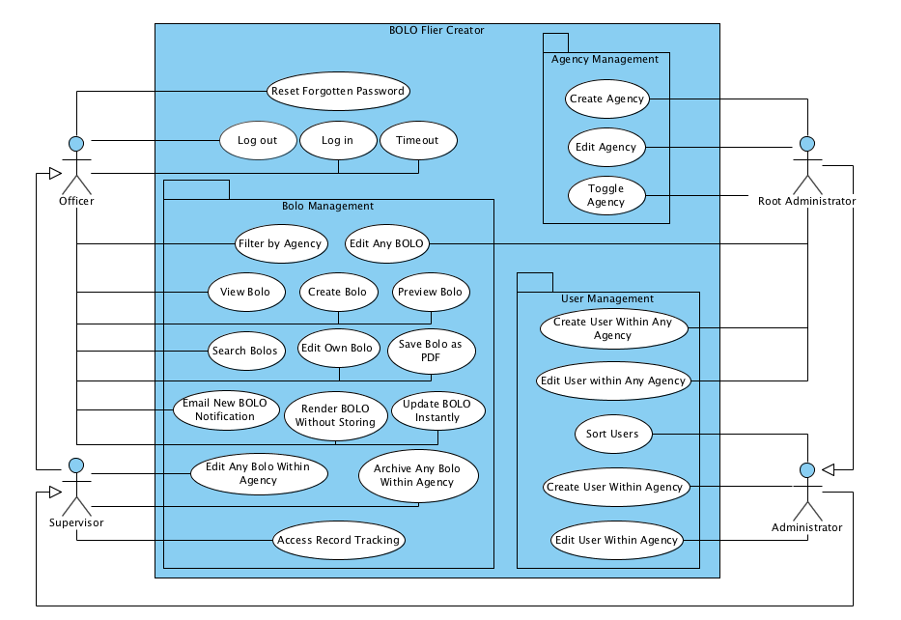
Requirements: Use Cases
Figure 3. Use Case Diagram
Notes:
4. Requirements:
4.1. User stories implemented (one or more slides).
4.2. UML use cases and the use case diagram for the implemented use cases (one or more slides).
4.3. UML sequence diagrams for the implemented use cases.

Slide 9
Significant Use case
Use case ID: Bolo-578
Flow of events:
The user clicks on ‘Create BOLO’ on the navigation bar.
The user is redirected to the ‘BOLO-Create-Form.’
The user enters data and attachments.
The user clicks on ‘submit.’
The system transforms the attachments and the form, then it stores them in the database.
The system returns the BOLO ID to the service.
The user is redirected to the ‘BOLO-List’ page.
Constraints:
The system should complete the storing process in less than 15 seconds.

Slide 10
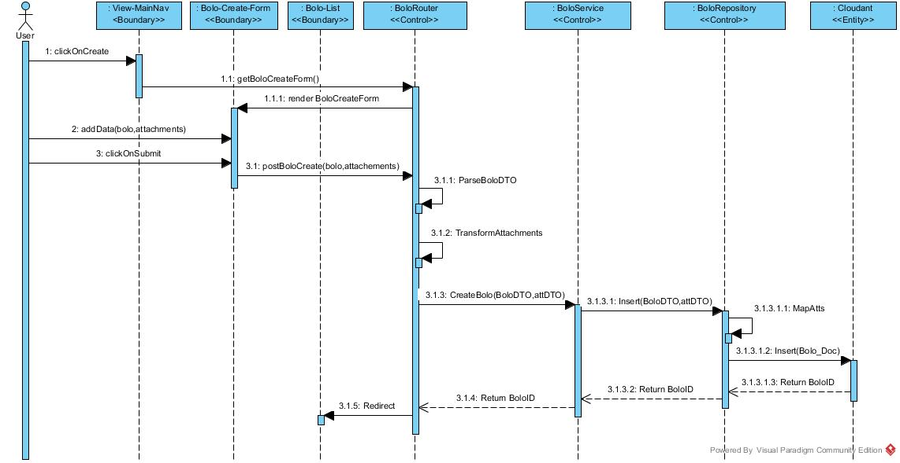
Significant Use Case: Create BOLO
Figure 4. Most significant sequence diagram
Notes:
4. Requirements:
4.1. User stories implemented (one or more slides).
4.2. UML use cases and the use case diagram for the implemented use cases (one or more slides).
4.3. UML sequence diagrams for the implemented use cases.

Slide 11
System Design: Architecture
Figure 5 – System Architecture
Notes:
5. System design:
5.1. System decomposition; identify the architecture patterns used (one slide).
5.2. System deployment – h/w and s/w requirements (one slide).
5.3. Persistent data design (one slide).
5.4. Security/Privacy (one slide).

Slide 12
System Design: Deployment
Figure 6 – Deployment diagram
Notes:
5. System design:
5.1. System decomposition; identify the architecture patterns used (one slide).
5.2. System deployment – h/w and s/w requirements (one slide).
5.3. Persistent data design (one slide).
5.4. Security/Privacy (one slide).

Slide 13
System Design : Persistent Data Design
Cloudant NoSQL DBaaS(Database as a service) provided by IBM Bluemix that offers a RESTful HTTP API
Scalability, Flexible Schema, Fast Development, Cost, Cloud Architecture Compatibility
Documents are stored in the popular JSON format with a flexible schema
Map-Reduce views to obtain data stored within the DB indexed by json type objects
Full text search which utilizes Lucene Query Parser Syntax(full featured text search engine)
Powered by Apache CouchDB, Dynamo Clustering, Lucene Search
Notes:
5. System design:
5.1. System decomposition; identify the architecture patterns used (one slide).
5.2. System deployment – h/w and s/w requirements (one slide).
5.3. Persistent data design (one slide).
5.4. Security/Privacy (one slide).

Slide 14
System Design : Security/Privacy
User Password validation through HMAC(Hash-based Message Authentication Code) using a SHA-256 algorithm and a unique password salt.
Cross-Site Request Forgery(CSRF) protection through the use of csrf middleware that embeds unique token into html form for user login page.
Secure cookies preventing client side script access, providing application timeout, and allowing communication only with HTTPS endpoints.
Authenticating HTTP requests through Passport authentication middleware.
Notes:
5. System design:
5.1. System decomposition; identify the architecture patterns used (one slide).
5.2. System deployment – h/w and s/w requirements (one slide).
5.3. Persistent data design (one slide).
5.4. Security/Privacy (one slide).

Slide 15
Minimal Class Diagram
Figure 7 – Minimal Class Diagram:
Notes:
6. Detailed design:
6.1. Minimal class diagram. Identify the design patterns used (one or more slides).
6.2. State machine for the main control object or the most important object of the implemented uses cases (one or more slides).
6.3. Main algorithm used related to an implemented use case described above (one or more slides).

Slide 16
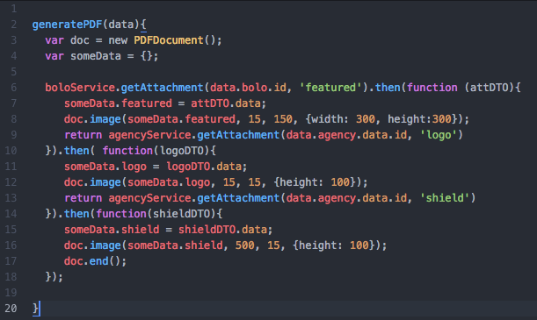
Main algorithm
Usecase #610 – Save as PDF: generatePDF algorithm:
Figure 8 – Main Algorithm: generatePDF()
Notes:
6. Detailed design:
6.1. Minimal class diagram. Identify the design patterns used (one or more slides).
6.2. State machine for the main control object or the most important object of the implemented uses cases (one or more slides).
6.3. Main algorithm used related to an implemented use case described above (one or more slides).

Slide 17
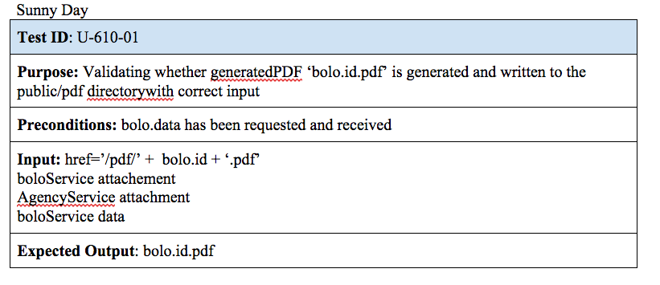
Test Cases
Use case #610: Save as PDF)
Figure 9 – Test Sunny Day : UserStory #610
Notes:
7. Test Suites and Test Cases (one sunny day and one rainy day) for the use case represented in part (5) above (2 slides).
7.1 One sunny day and one rainy day for the implemented use cases (one or more slides).
7.2 Automated test scripts for the implemented use cases (one or more slides).

Slide 18
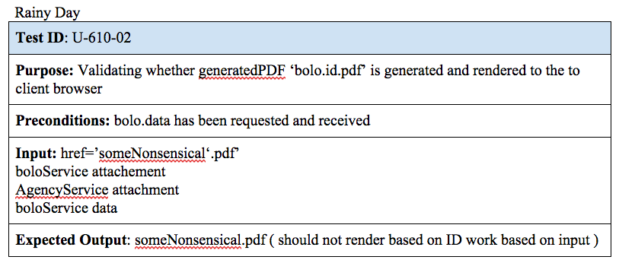
Test Cases
Use case #610: Save as PDF)
Figure 10 – Test RainyDay : UserStory #610
Notes:
7. Test Suites and Test Cases (one sunny day and one rainy day) for the use case represented in part (5) above (2 slides).
7.1 One sunny day and one rainy day for the implemented use cases (one or more slides).
7.2 Automated test scripts for the implemented use cases (one or more slides).

Slide 19
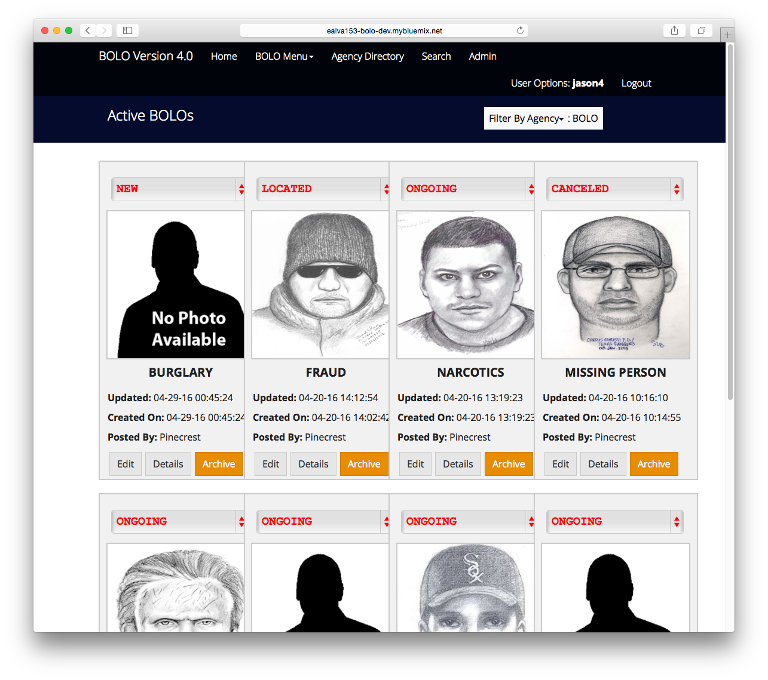

Slide 20
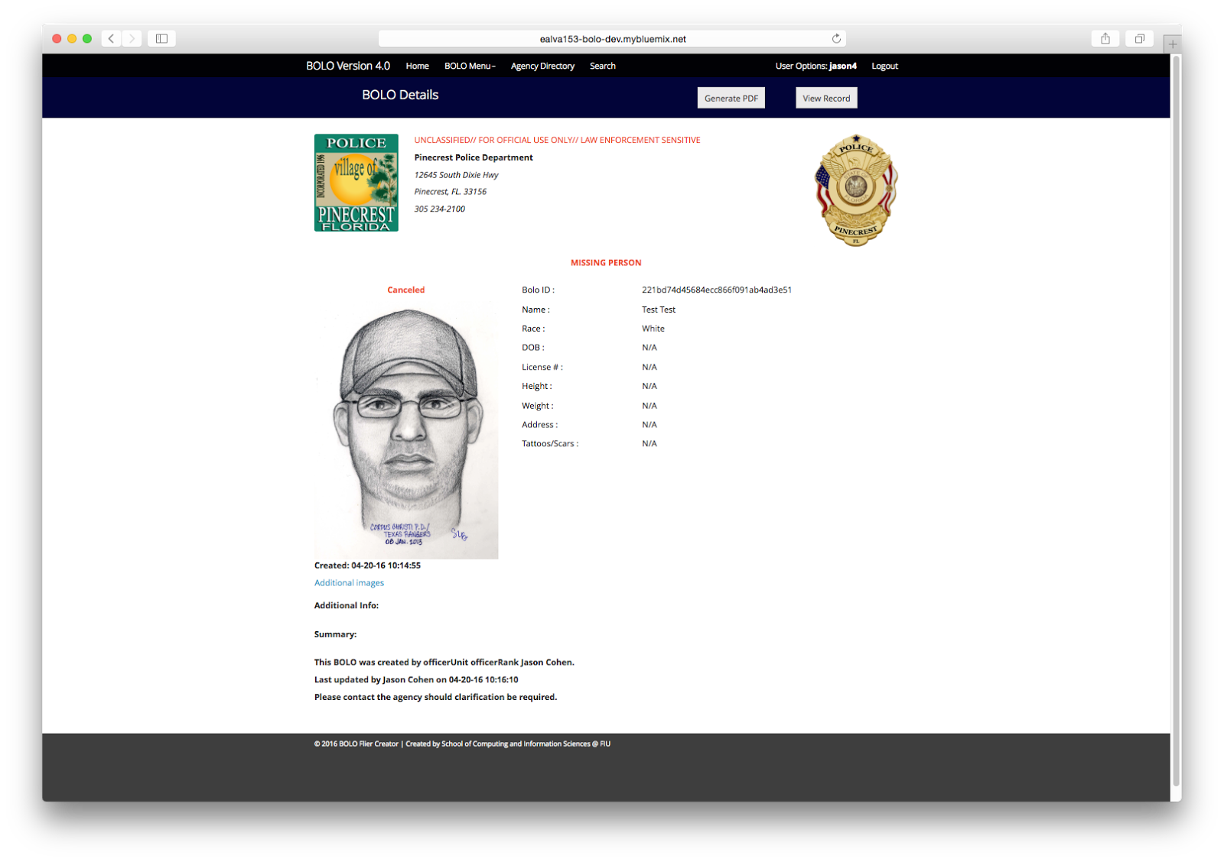

Slide 21


Summary
SUMMARY:
Implemented Email Services
Implemented PDF Services
BOLO 4.0 generates PDF documents of issued BOLO’s to be effective
BOLO 4.0 helps law enforcement agents in realizing an advanced and rapid crime information sharing system
Huge effort and making communities in Miami-Dade County safer
Alejandro Henao (ahena001@fiu.edu)
Notes:
Summarize your contribution
Include your contact information
Ask if anyone has any questions for you.
Thank your audience

Slide 22
Questions?
Thank you for attending!
Figure 10 – Smiley Face
Notes:
Summarize your contribution
Include your contact information
Ask if anyone has any questions for you.
Thank your audience

